Slide 1

INTERNET of TUNNEL
Davide Avesani, Simone Pascucci, Gavriel Di Nepi

Slide 2
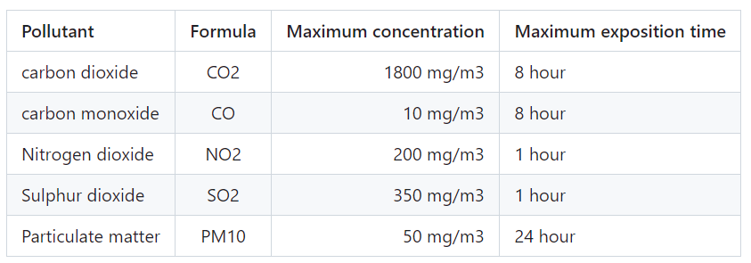
Technical aspects
The air quality system must be based on a list of air pollutants to be monitored and their respective threshold values. Also, the minimum level of light to be guaranteed inside the tunnel must be clearly defined.
Ambient Air Quality and Clean Air for Europe Standards of 2008.

Slide 3

Adapting the Prototipe
We tried to design a prototype that reflects in a reasonable way a real case scenario, by making feasible estimations and assumptions in relation to the equipment at our disposal. The dimensions of the cardboard used to simulate the tunnel are 50cm x 40cm x 80cm, resulting in a total air volume of 0.18m³.

Slide 4
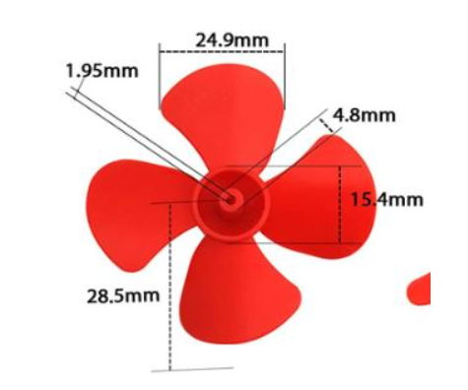
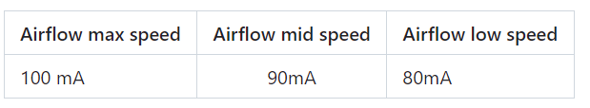
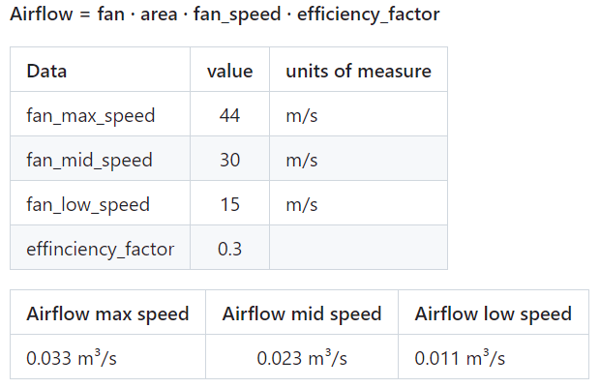
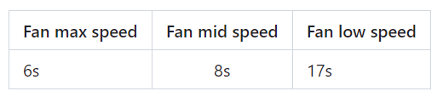
FAN

Slide 5
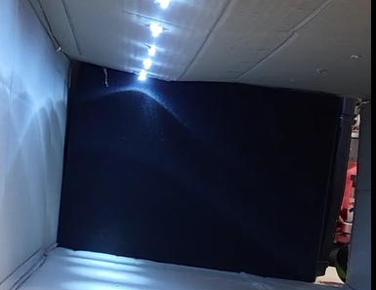
LIGHT
Cone of light on the bottom with a radius of 15cm.
Six light bulbs to adequately illuminate the entire length of the cardboard.
Recorded light intensity reached approximately 1600 units on the bottom and 50 on the side.

Slide 6
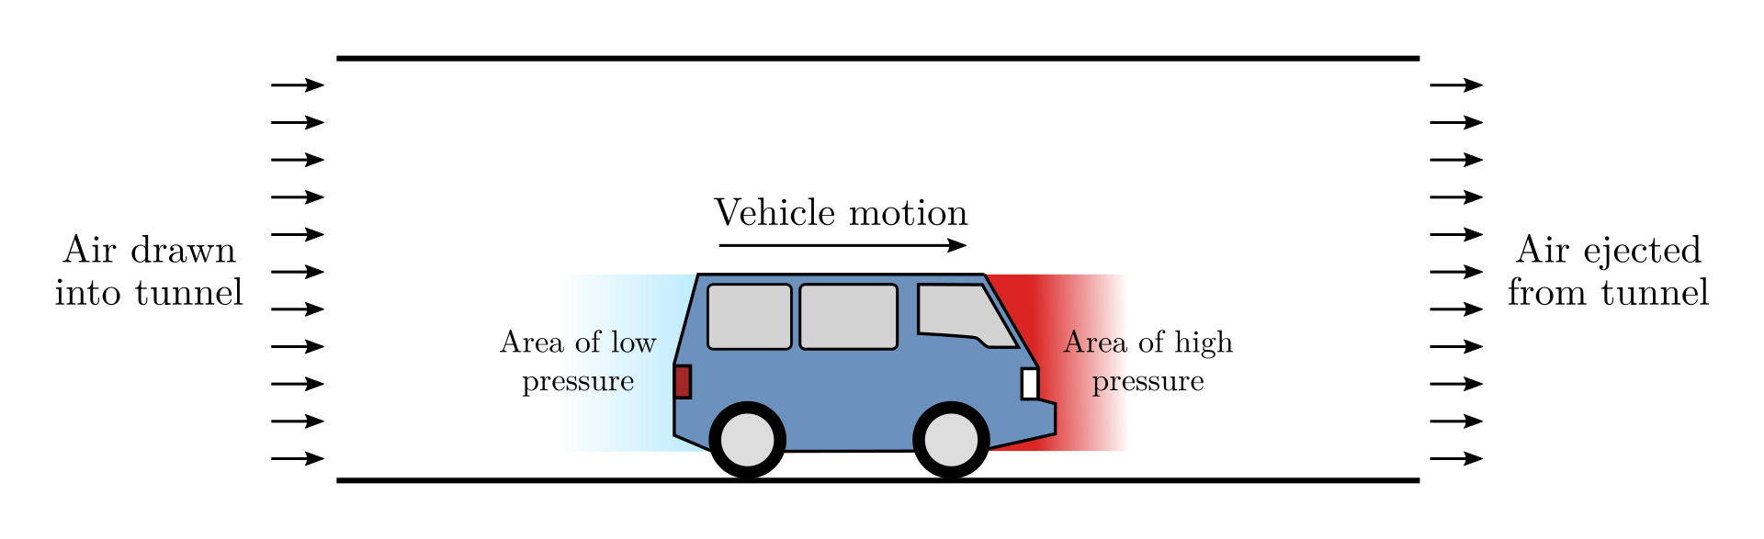
PISTON EFFECT
In open air, when a vehicle travels along, air pushed aside can move in any direction except into the ground.

Slide 7

measurements
AIR QUALITY:
Normal conditions every 10 minutes
High concentation of pollutant every 6, 10, 17 seconds.
LIGHT CONDITIONS
In normal conditions every 15 miniutes, it is the time for a thunderstorm to arrive or for the sunset.
If high variation of light during measurements it decreases.

Slide 8
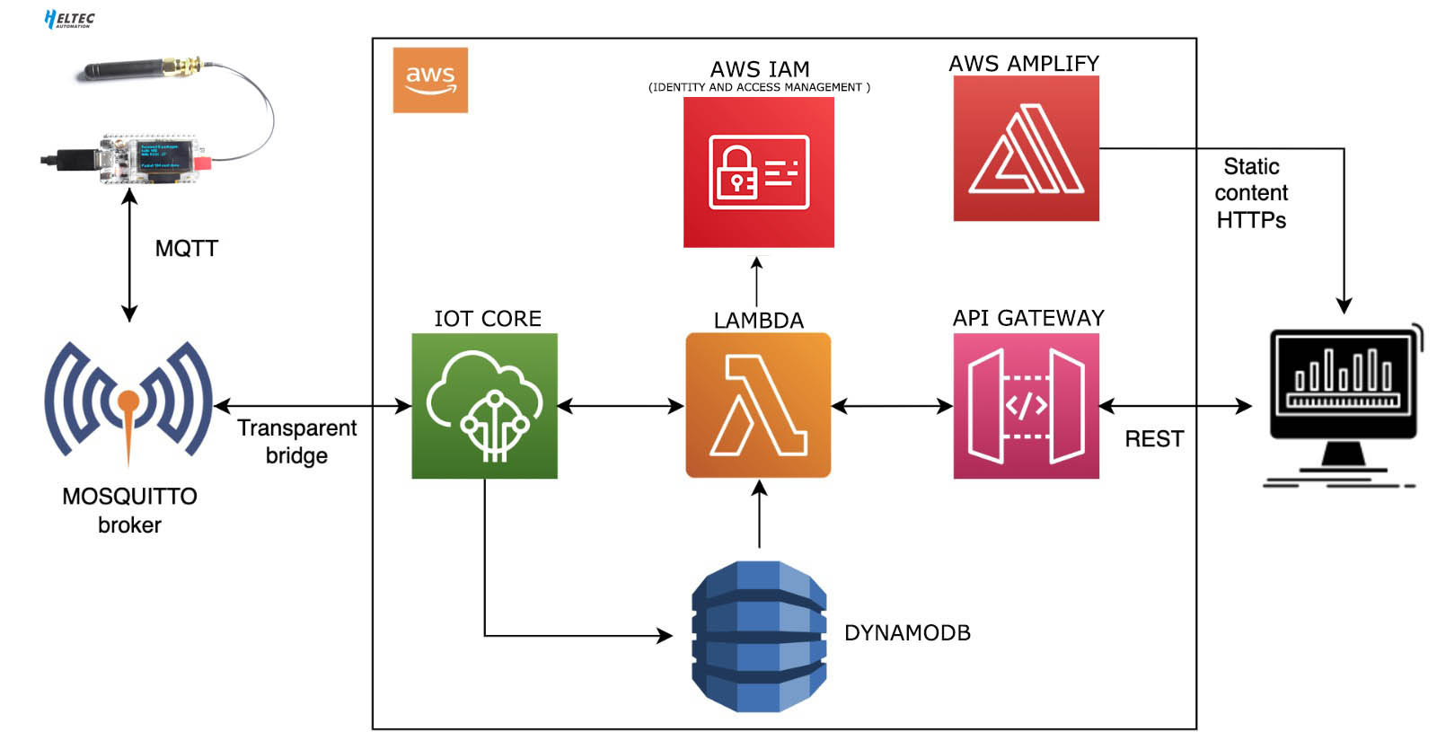
CONNECTING THE COMPONENTS
Network architecture

Slide 9
Evaluation
Simply the main goal is to keep the values within the treshold of the regulamentation with as les energy consumption as posible.
The energy consumption depends almost only by the actuators
Light bulb energy consumption | Fan bulb energy consumption
1W | 0.1 W

